Slide 1

Smart Headphones
Presentation By:
P. Girish Kumar (17K61A05F9)
IV-B.Tech(CSE-A)

Slide 2
Contents
Introduction
Purpose
Working
Power Consumption and Price Break Down
Advantages
Disadvantages
Conclusion
References

Slide 3
Introduction
Headphone-wearing pedestrians often can't hear the auditory cues like horns, shouts, or the sound of approaching cars that signal imminent harm.
This negligence of the pedestrians can cause a fatal accident.
This phenomenon affects cities globally, and is an important societal problem.
So to solve this problem researches are developing a wearable device that actually warns the pedestrians about oncoming vehicles to avoid accidents.

Slide 4
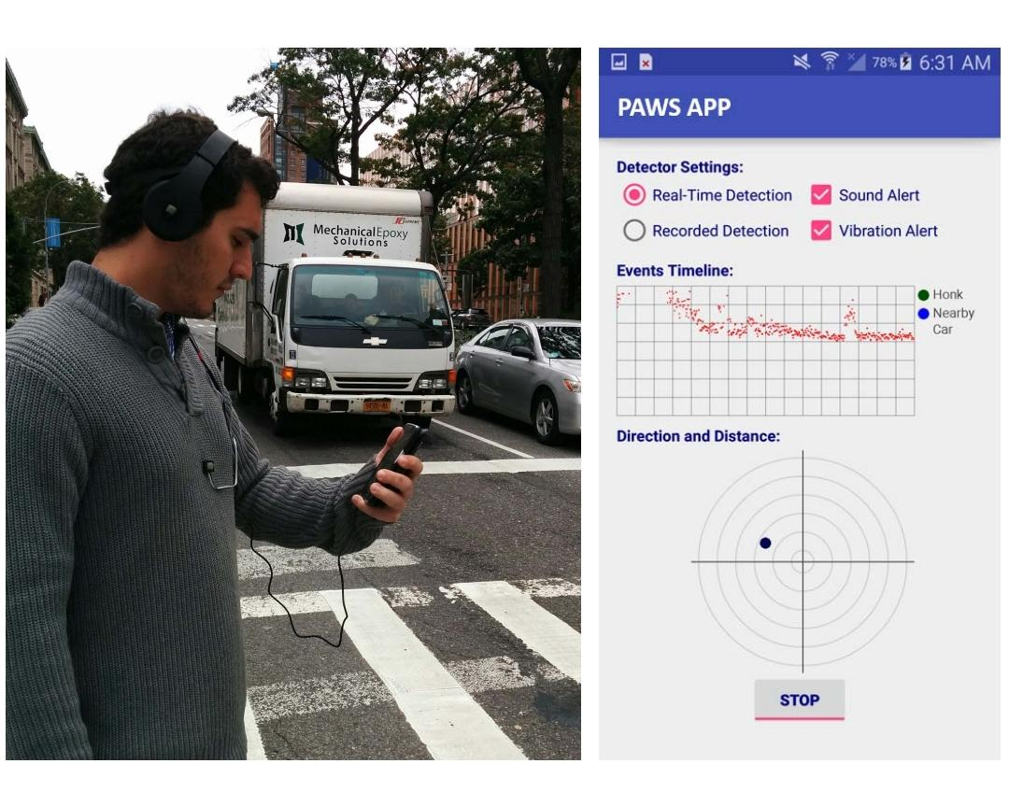
Purpose
PAWS, Pedestrian Audio Wearable System is a wearable headset platform and Smartphone application that uses five microphones and a set of machine learning classifiers to detect, identify, and localize approaching cars in real time and alerts the user using audio/visual feedback through a Smartphone.

Slide 5
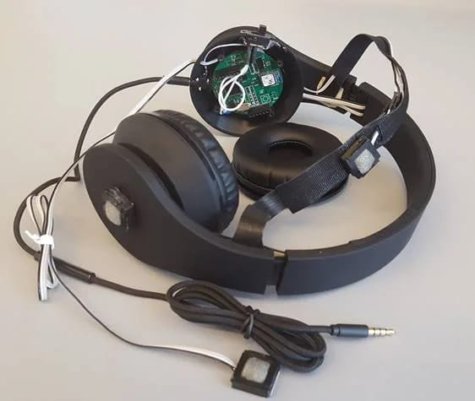
Working
The system consists of three main components:
Five MEMS microphones;
Front-end hardware for multichannel audio feature extraction and
A Smartphone host for machine learning-based vehicle detection and localization
Four of the MEMS microphones, labeled MIC1 to MIC4, are distributed over the user, at the left and right ear, back of the head, and in front of the user, to provide relevant information about the sound source’s location.
The front-end hardware acquires signals from these microphones and locally extracts acoustic features that are used by a Smartphone application

Slide 6
The standard microphone of the headset (the fifth micro-phone, MIC5) is connected to the 3.5-mm audio input of the phone. Data from the fifth microphone is directly acquired by the smartphone.
Using the features computed by the front-end hardware and an audio stream from the headset microphone as inputs, machine learning classifiers running inside the PAWS application detects the presence of an approaching vehicle and estimates its position relative to the user.
The Smartphone uses acoustic features received from the embedded front-end system to estimate the distance and direction of the car.
The MCU must sample the data from the four MEMS microphones and perform feature extraction, while the BLE module is responsible for transferring the calculated features to the Smartphone.

Slide 7
Alert Mechanism:
The application alerts a user with audio/visual feedback. If a car is detected within a user-configured distance range (e.g., 40 m)—the phone vibrates, lowers the volume, and beeps.
It can also be configured to play a customized message, e.g., “a car is {approaching, honking} on your {direction, left, right}.”
The application also visually shows the location and direction of the car on its user interface.

Slide 8
Power Consumption and Price Breakdown
This evaluate the energy consumption of PAWS low-energy by measuring the power consumptions for both the embedded platform and the smart phone.
The overall power consumption of the system is below 70mA, allowing for 17 h of continuous operation when powered by 3 AAA Alkaline batteries.
The entire setup will be released for less cost.

Slide 9
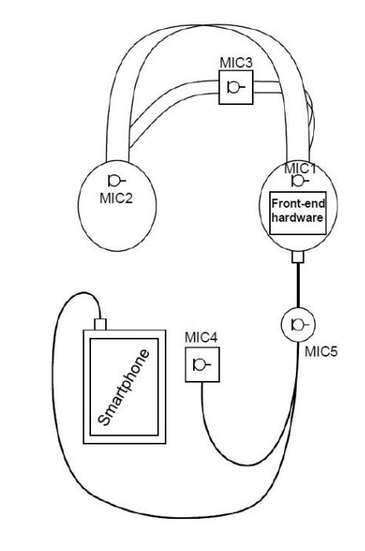
Block Diagram

Slide 10
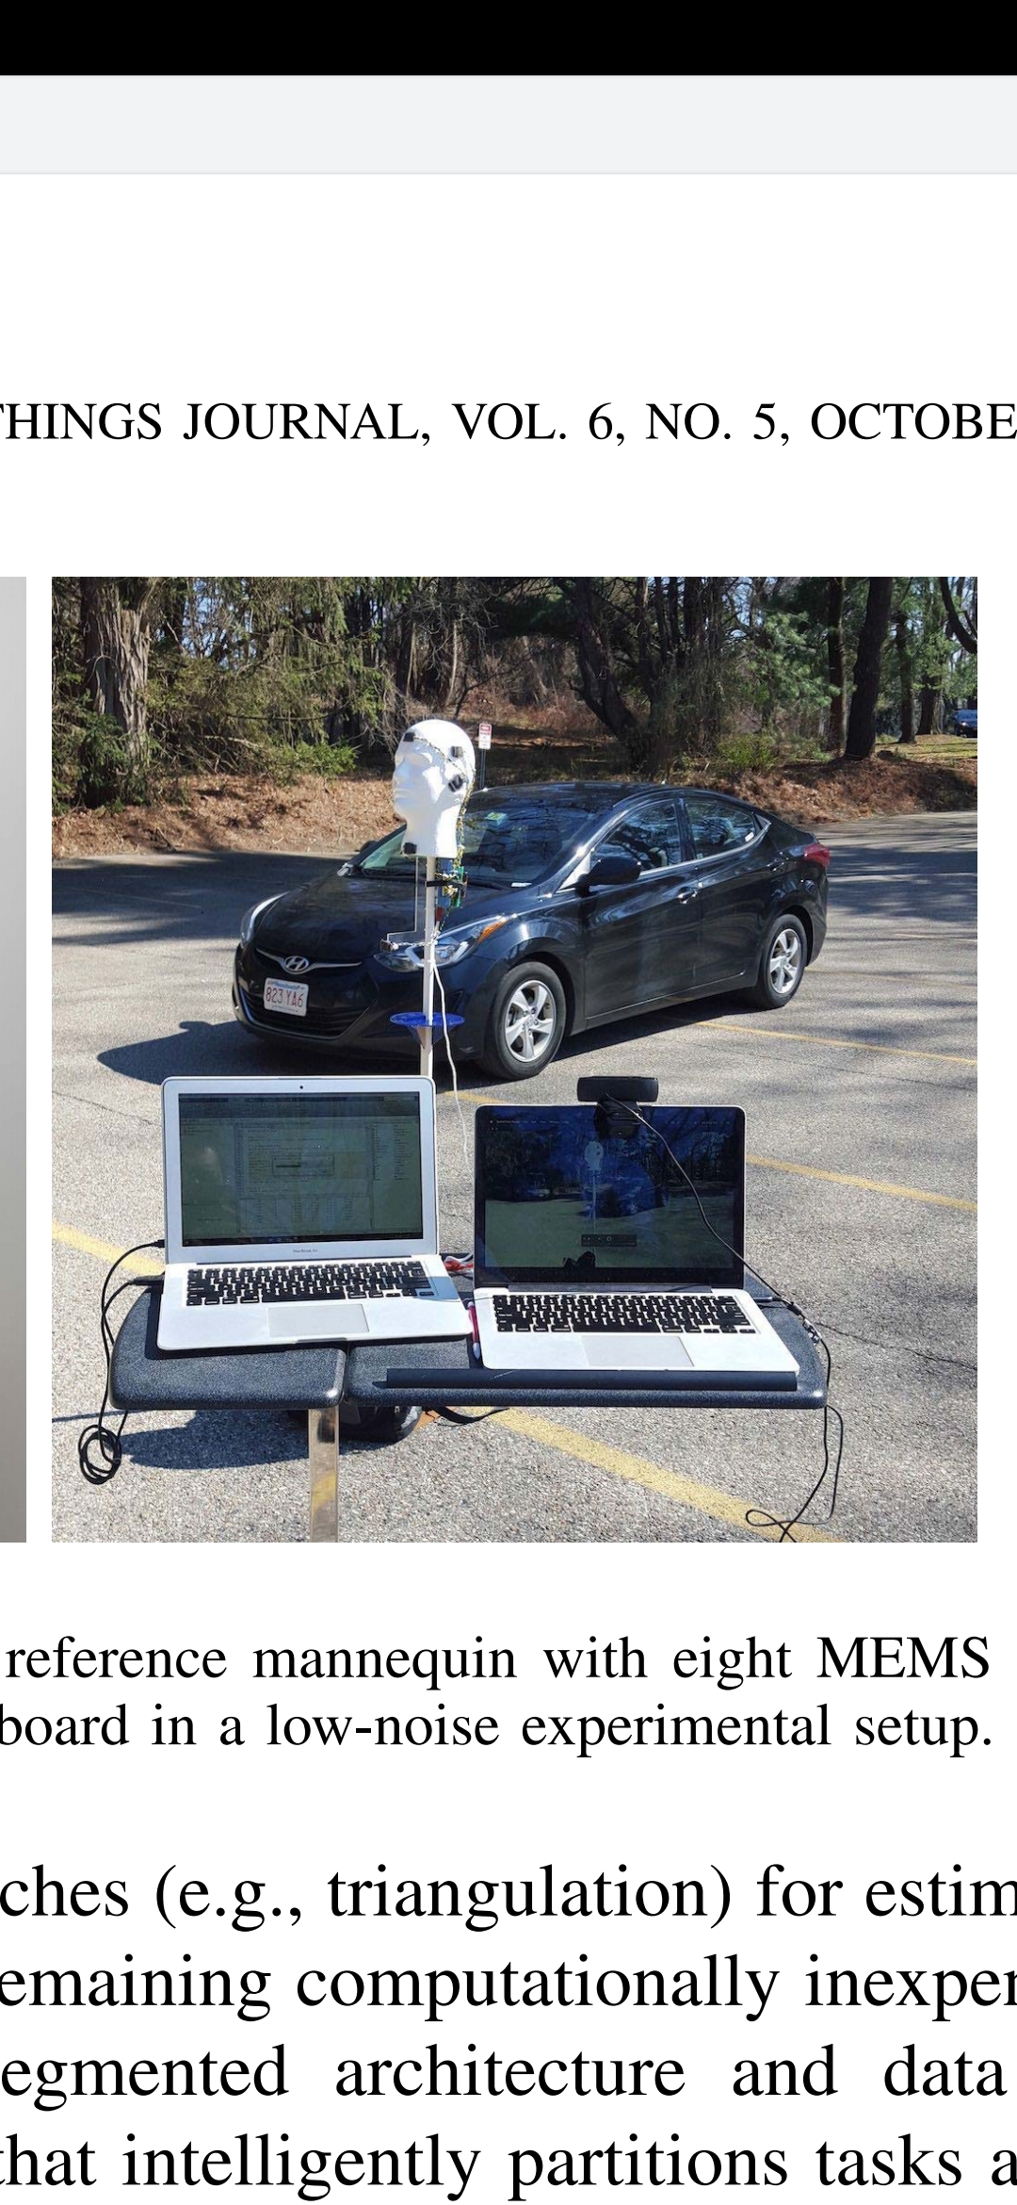

Slide 11
Advantages
Inexpensive
Low Battery Usage
Reduces Pedestrian Accidents
Provides Safety
Disadvantages
Covered Microphones: If the microphones are covered then PAWS would be rendered ineffective.
Noisy Streets: Streets may contain different types of noise, so the system should be well trained with as many scenarios as possible.

Slide 12
Conclusion
As technology evolves , new dangers surround modern cities. So innovative safety solutions must arise to uphold the welfare of common citizens.
With the help of this Smart Headphones , further to
provide solution to twalking.

Slide 13
References
[1] IEEE INTERNET OF THINGS JOURNAL 1 Improving Pedestrian Safety in Cities using Intelligent Wearable Systems Stephen Xia, Daniel de Godoy, Bashima Islam, Md Tamzeed Islam, Shahriar Nirjon, Peter R. Kinget and Xiaofan Jiang
[2] Data Science Institute at Columbia. "Researcher designs headphones that warn pedestrians of dangers." ScienceDaily. ScienceDaily, 9 December 2019.

Slide 14
Thank You

